Slide 1


Enhancing Gift Recommendations with RAG
By,
Amulya Murahari - 002738903
Namitha J C - 0027195461
Sinchana Kumara - 002780971
Prompt Engineering and AI
16/07/2024

Slide 2



Introduction
The objective of a gift recommendation system is to streamline the gift-giving process by suggesting personalized options that align with user preferences and historical data, enhancing satisfaction and efficiency
Vision
Goal
Strategy
To build an accurate platform for personalized gift recommendations, enhancing the joy of giving by ensuring every gift is meaningful and cherished.
To achieve a 90% satisfaction rate among users by providing accurate and personalized gift recommendations.
Leverage advanced AI algorithms to analyze user preferences and behavior, continuously refining our recommendations to ensure highly personalized and accurate gift suggestions.

Slide 3
Importance and Relevance to the Course and Industry
1
This project integrates advanced AI and data analytics, aligning with course objectives of practical application of machine learning and software development
2
It addresses industry needs for personalized user experiences and enhances e-commerce by simplifying the gift-giving process, making it highly relevant and impactful.

Slide 4
Project Description:
Specific Problem Aimed to Solve:
The Gift Recommendation System uses machine learning to suggest personalized gifts based on user input, analyzing historical data and preferences. It features a user-friendly interface for specifying criteria like budget and interests.
The system simplifies the stressful process of finding suitable gifts by providing tailored suggestions that match the recipient's tastes and preferences. This reduces uncertainty and decision fatigue, enhancing the gift-giving experience.

Slide 5
Scope of the Project:
1
2
3
4
5
User Interface Development
Data Collection and Analysis
Algorithm Implementation
Testing and Iteration
Integration and Deployment
Design an intuitive, responsive application for users to specify gift criteria.
Gather and update data on user preferences and purchasing patterns.
Develop machine learning algorithms to predict and recommend gifts
Conduct rigorous testing and gather user feedback
Integrate with e-commerce platforms or operate as a standalone app

Slide 6
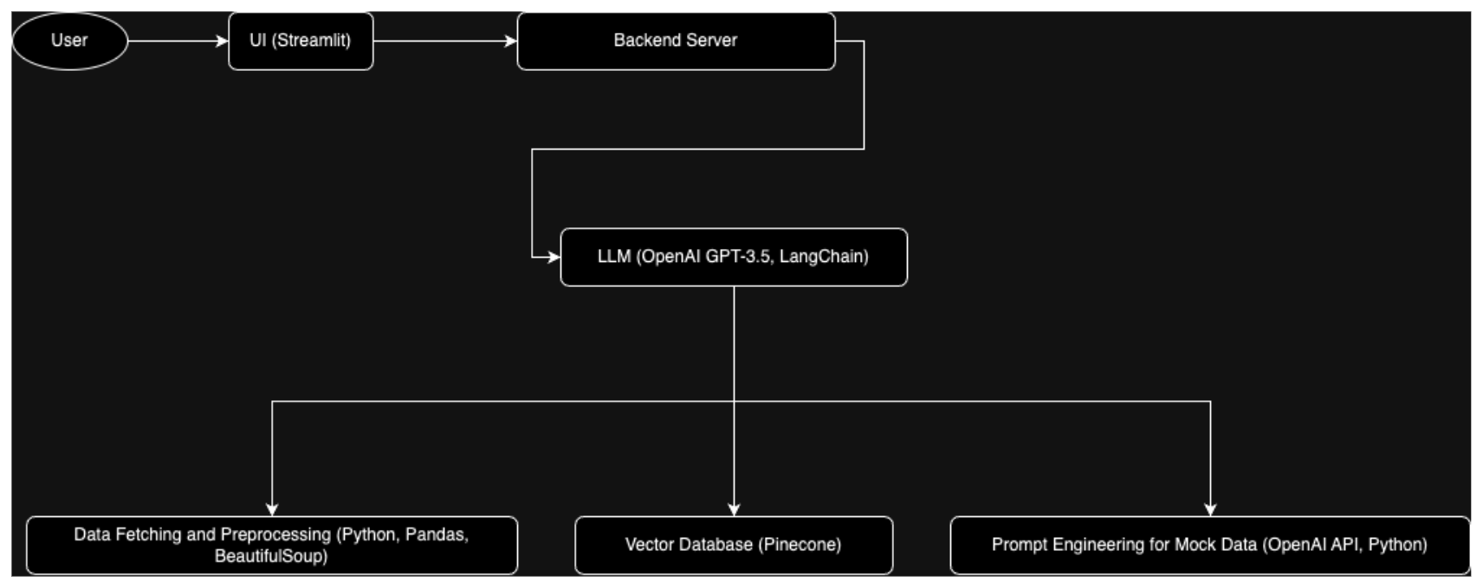
Project Architecture

Slide 7
Project architecture
Technologies and Tools Used:
Streamlit: Interactive UI
OpenAI GPT-3.5 & LangChain: Natural language processing
Pinecone/Weaviate: Vector databases
Python, Pandas, BeautifulSoup: Data fetching and preprocessing
OpenAI API: Prompt engineering

Slide 8

Project Architecture
Component
Description
User Interface
A responsive web application built with Streamlit that allows users to specify their gift-giving criteria, such as budget, recipient's interests, and occasion.
Data Collection and Preprocessing
A system that gathers data on user preferences, gift items, and purchasing patterns, and preprocesses the data for input into the recommendation model.
Recommendation Algorithm
Machine learning models, such as those based on OpenAI GPT-3.5 and LangChain, that analyze the user input and past data to generate personalized gift recommendations.
Data Storage
A vector database, such as Pinecone or Weaviate, to efficiently store and query the data used by the recommendation algorithm.
Integration and Deployment
The system will be designed to be easily integrated into existing e-commerce platforms or to operate as a standalone application, with a focus on scalability and reliability.

Slide 9
Data Collection and Preprocessing
Source and Nature: Collected data from Kaggle.com and includes categorical data , numerical data and textual data.
Steps Taken for Data Collection:
Data Preprocessing Techniques Used:
Kaggle Dataset Utilization: A pre-compiled dataset from Kaggle containing comprehensive gift recommendation data.
Cleaning: Remove duplicates, handle missing values, correct inconsistencies in the dataset.
Categorization: Classify gifts into categories based on type, occasion, recipient demographics.
Text Preprocessing: Utilize NLP techniques to process textual data.

Slide 10



RAG Pipeline Implementation
Overview of the RAG Pipeline: Combine the power of dense retrieval with a sequence-to-sequence model for generating recommendations
Steps
Retrieval Setup:
Generation:
Indexing: Create a searchable index of gift data using embeddings
Context Integration: Fuse retrieved documents into the decoder of a generative model.
Query Processing: Transform user queries into embeddings using the same model.
Output Generation: Generate personalized gift recommendations
Challenges and Solutions :
Scalability: Handling large volumes of data and queries.
1
Solution: Use efficient indexing and query techniques such as FAISS.
2
Accuracy: Ensuring the relevance of retrieved documents.
Solution: Continuously train and refine the retrieval model with user feedback.

Slide 11
Performance Metrics
1
Key Metrics to Evaluate the Project
Precision and Recall: Measure the relevance of the recommendations.
Latency: Time taken to generate recommendations.
2
Methods Used to Calculate These Metrics
Precision/Recall Calculation: True positives, false positives, false negatives from test cases.
User Surveys: Surveys to capture direct user feedback on recommendation relevance.
Latency Measurements: Monitor backend logs to assess response times.
3
Initial Results and Observations
Effectiveness: Early tests show promising precision and recall in controlled settings.
User Feedback: Positive feedback, highlighting the personalization of the recommendations.
Performance Issues: Identified latency spikes during high query volumes

Slide 12
Methods to Improve Metrics
Identifying Weak Areas:
By analyzing the calculated metrics to we will identify weak areas.
Improvements Proposed:
According to the calculated metrics, we will work on modifying the model. For example:
Improving Context Precision:
Improving Faithfulness:
Noise Injection During Training:
Use more advanced algorithms like BM25 to improve context retrieval.
Fine-tune the generative model with more accurate data.
Train the model with noisy data to make it more resilient to real-world noisy inputs.

Slide 13
Deployment Plan
1
Prepare The Application
Ensure Streamlit application code is clean, well-documented, and tested locally.
2
Set Up a GitHub Repository
Push your Streamlit application code to this repository.
3
Deploy to Streamlit Cloud
Log in to Streamlit Cloud and connect your GitHub repo.
Specify branch and main Python file.
Deploy and configure settings.
4
Tools and Platforms for Deployment
Streamlit Cloud
GitHub
5
Plan for User Testing and Feedback
Beta Testing - Share with select users.
Iteration - Update based on feedback.

Slide 14


Future Work
Enhanced Retrieval Techniques:
Scalability:
Exploring and implementing more advanced retrieval techniques (e.g., hybrid models combining keyword and neural retrieval).
Ensure the application can handle increasing user loads.
User-Centric Improvements:
Advanced AI Models:
Focus on enhancing user experience through continuous feedback and iteration.
Incorporating the latest advancements in AI and NLP for better performance.

Slide 15






Conclusion
The Gift Recommendation System leverages machine learning to provide personalized gift suggestions based on user input, including budget, recipient's interests, and occasion. By analyzing historical data, user preferences, and demographics, it generates tailored recommendations. The system's user-friendly interface ensures optimized and relevant gift options for enhanced customer satisfaction.
Key takeaways
Introduction to RAG and Gift Recommendation
Leveraging diverse data sources and sophisticated preprocessing ensures a robust foundation for personalized gift recommendations.
RAG Pipeline Implementation
The RAG pipeline effectively combines retrieval and generation techniques to deliver personalized and timely gift suggestions.
Performance Metrics
Precision, recall, and user satisfaction rate are critical metrics demonstrating the effectiveness and efficiency of the gift recommendation system.
Metric Improvement
Specific strategies and their impacts.
Deployment
Effective steps and tools for deploying the application.
Future Work
Vision for extending and enhancing the project.

Slide 16
Thank You!
We're open to Q&A now.

